Slide 1
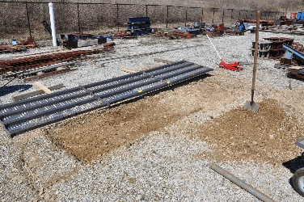
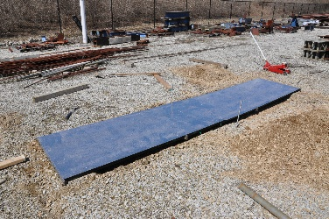
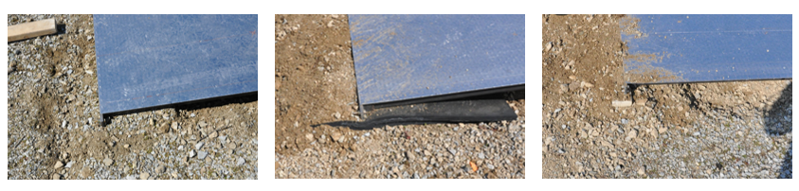
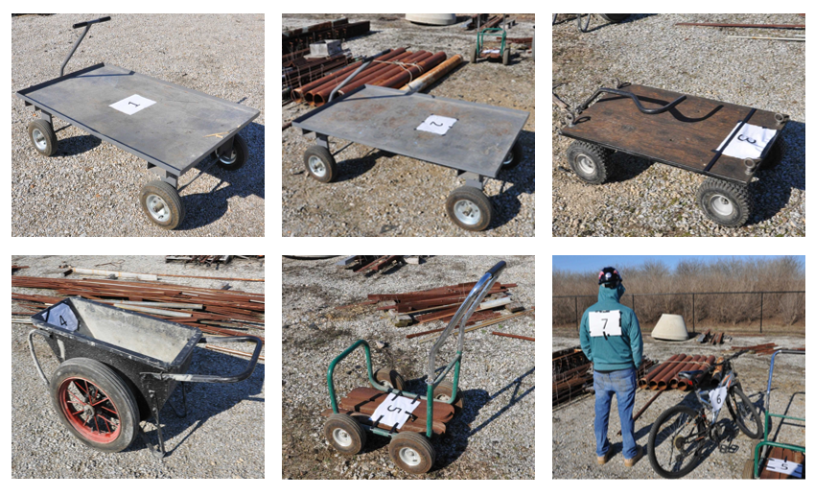
Bridge installation
B1 (gravel)
B2 (rubber)
B3 (wood)
Installation of 8 accelerometers.
1024 Hz sampling frequency
Pulling the vehicles by three different people
Starting from outside of the bridge
Acquisition of 864 sample data (8 x 6 x 3 x 6 = 864)
6 vehicle (V1, V3, V4, V5, V6)
6 Run (3 forward, 3 backward)
8 Sensors
3 Boundary (BG, BR, BW)
V1
V2
V3
V4
V5
V6
Testing vehicles

